Slide 1
&
Successful Posters Presentations
Stacia (Whitworth) Miller & Julie Scales

Slide 2
Notes:
A little bit of time invested now is the key to…

Slide 3
Notes:
Preventing this

Slide 4
Notes:
And instead experiencing this

Slide 5
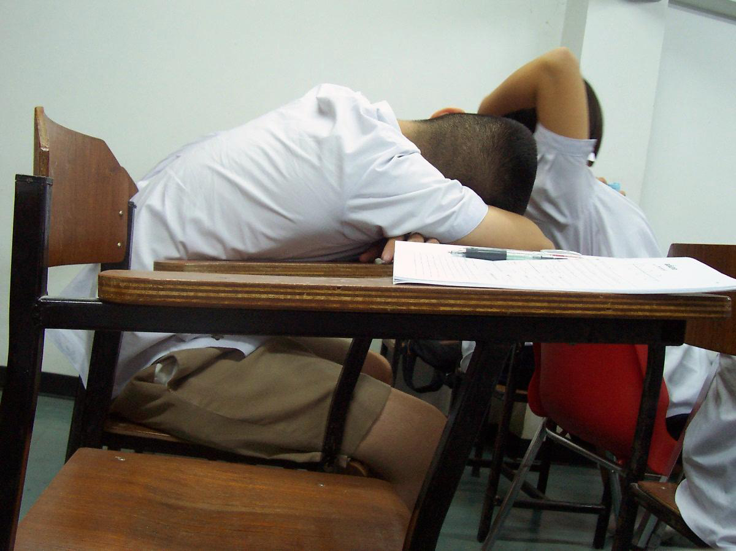
Notes:
So that instead of your audience doing this

Slide 6
Notes:
They will be like this.

Slide 7
Agenda
Presenting your work
Design
Oral presentations
Poster presentations

Slide 8
Presenting Your Work
Notes:
Think back to presentations you have seen. What are come characteristics of an effective presentation? What are some characteristics of less effective presentation?
We want to give you tools to help you put together an effective presentation. Why do you want to have a good presentation? Here are a few reasons:
--Get people interested in your work
--Effectively communicate your work
--Demonstrate your expertise
Anytime you are sharing your work, whether that be through a presentation, poster, paper, or other communication venue, think of it as a professional opportunity. The person who is reading/seeing/listening to your work could be a potential employer or funder or they could know someone who is. This can be a chance for you to network, practice networking, and further your career. Your ability to communicate effectively with different types of audiences reflects upon you.

Slide 9
A
+
Audience
Purpose
Format
Notes:
If you want to be a stellar communicator, you must always keep one thing in mind.
Who is your audience?
What are their needs? Put yourself in their shoes. Think from their perspective
This is the most important piece of information shared here.
Your audience should walk away with an appreciation for what you do.
What is the take home message for your talk? For your slide? What do you want them to do/think/know/believe?
Big picture → your results → big picture (and how you have changed it, what does this all mean)
Tell them an interesting story. You can do this in a variety of formats.

Slide 10
PRESENTATIONS

Slide 11
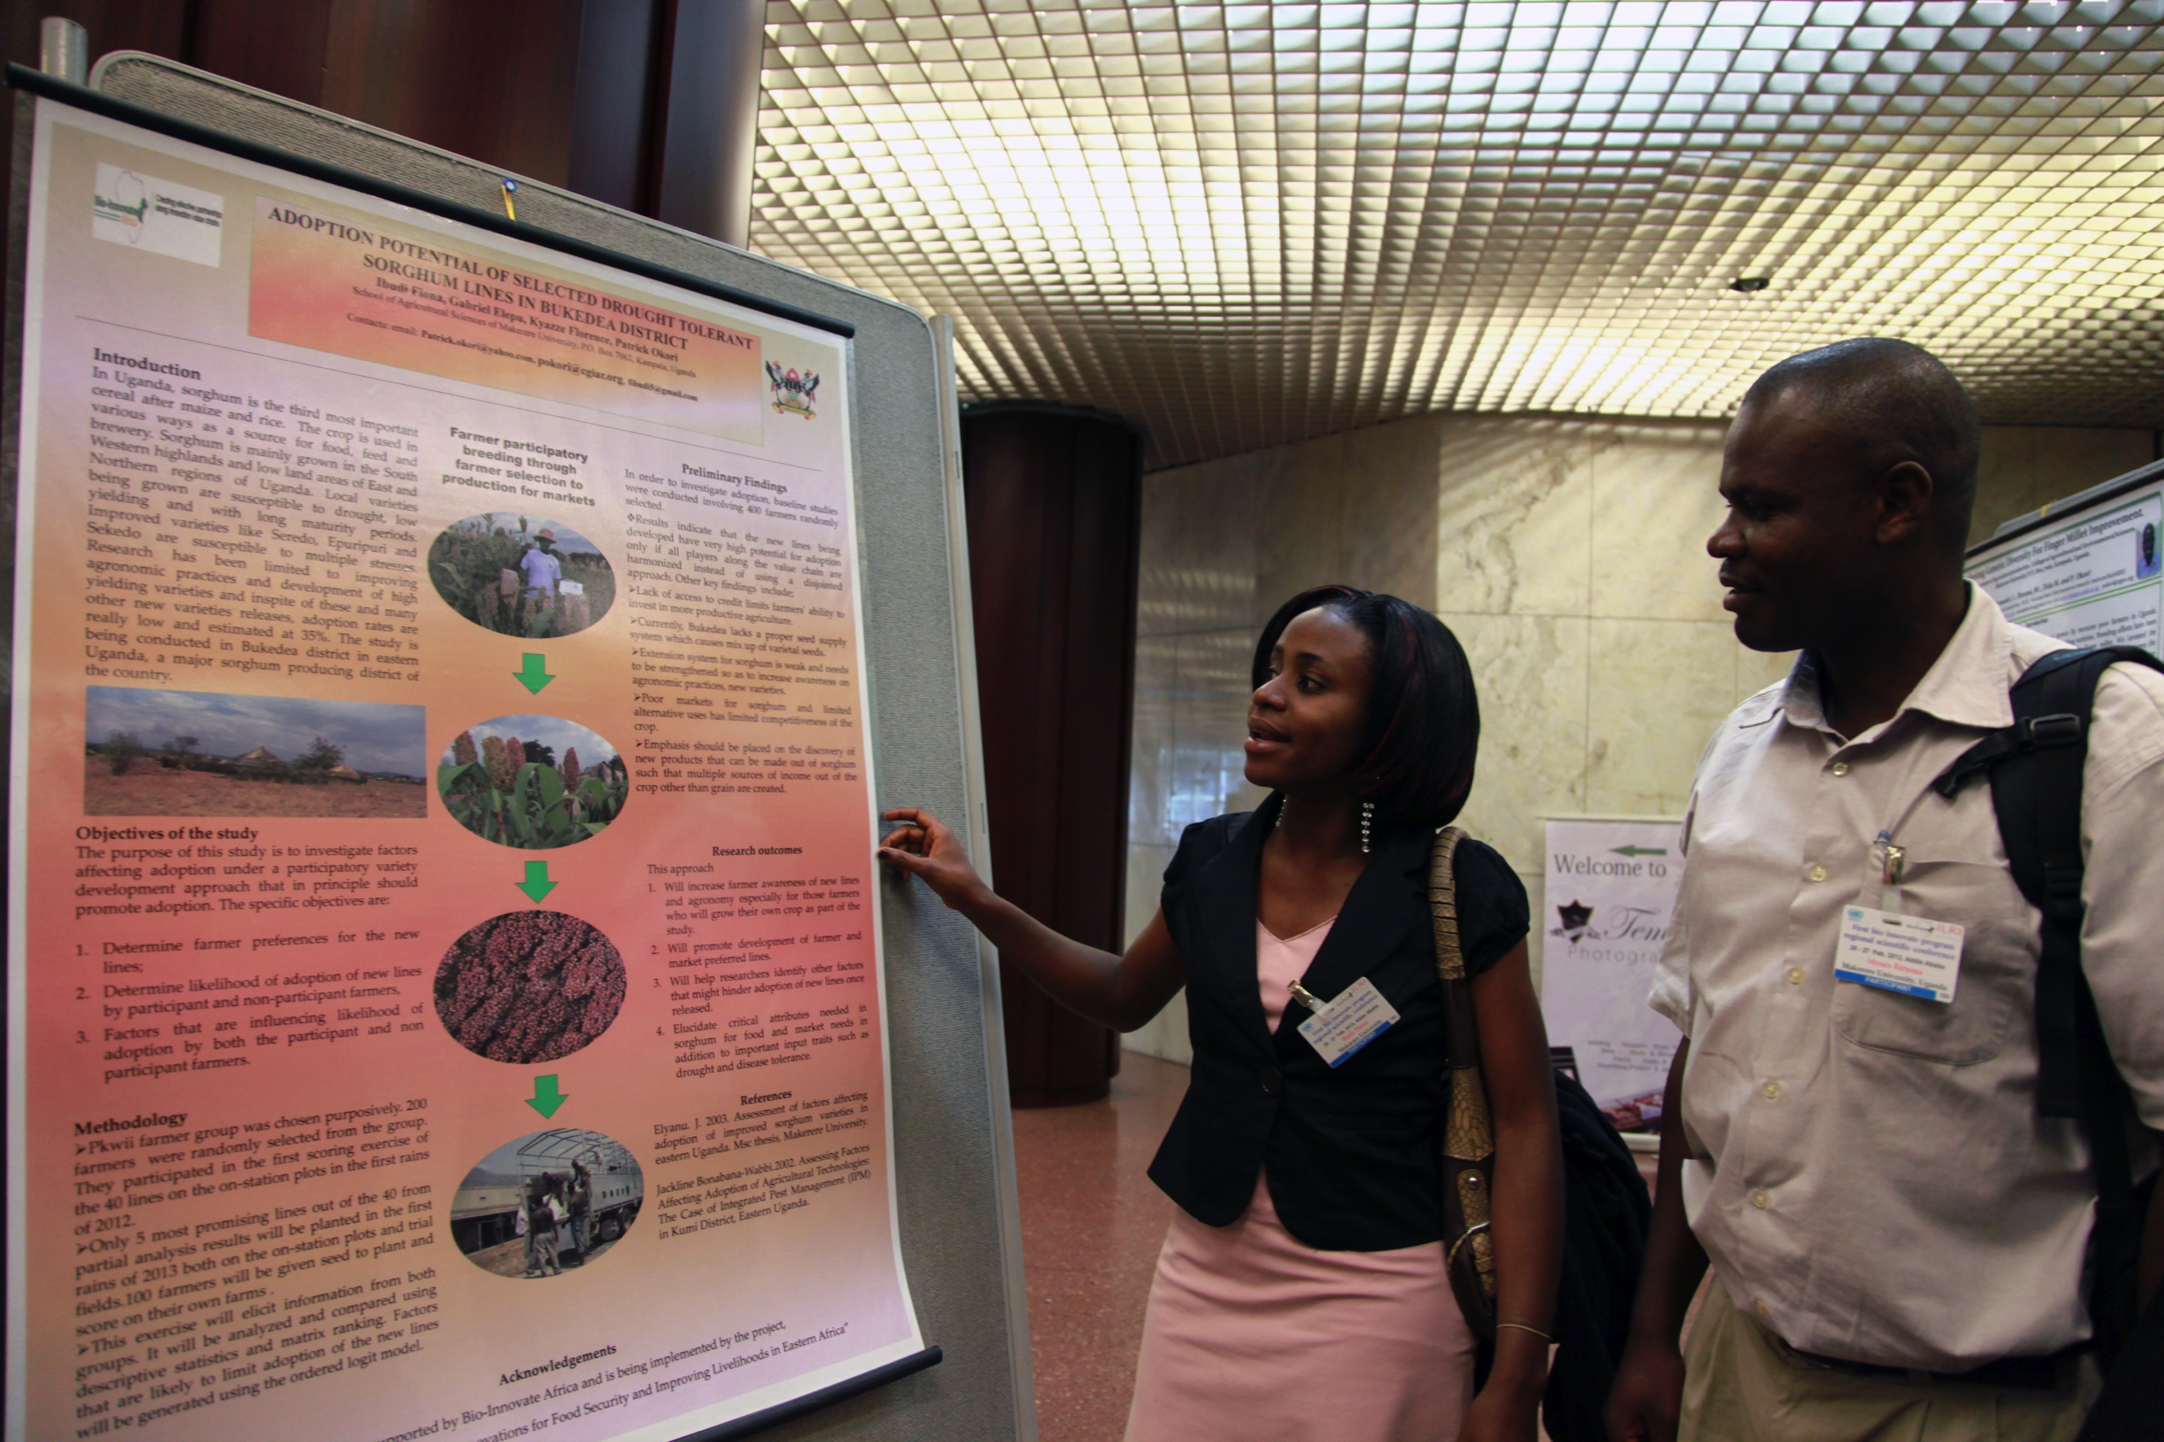
POSTERS

Slide 12
One size does not fit all
Notes:
You tailor your message differently for different audiences and for different formats.

Slide 13
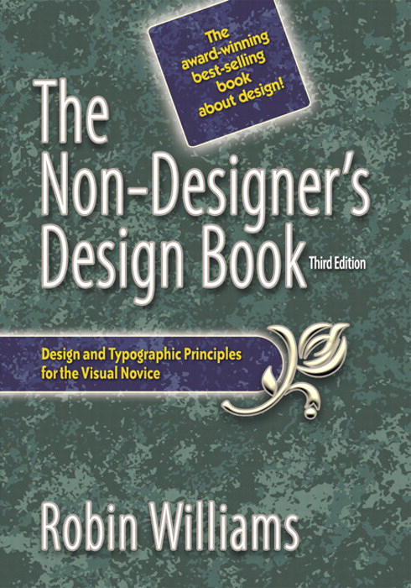
DESIGN
Notes:
You tailor your message differently for different audiences and for different formats.

Slide 14
C
R
A
P
Notes:
Here’s the word you need to remember.

Slide 15
CONTRAST
REPETITION
ALIGNMENT
PROXIMITY

Slide 16
CONTRAST
R
A
P
Notes:
Contrast helps you to create interest, organize information, direct the audience’s eye, and apply hierarchy
It is a good way to add visual interest to your piece. Visual interest can make your audience want to look/read/learn more.
Contrast is when two elements are different. If they are just a tiny bit different, it’s doesn’t really work. Contrast needs to be noticeably different.
You can create contrast with size (big and little), thin lines vs. think lines, colors. But again, they need to be noticeable. 12-point font vs. 14-point font doesn’t work.

Slide 17
CONTRAST
R
A
P

Slide 18
CONTRAST
R
A
P
Notes:
Is this a good contrast?

Slide 19
CONTRAST
R
A
P
Notes:
Is this a good contrast?

Slide 20
CONTRAST
R
A
P
Notes:
What about this?

Slide 21
CONTRAST
REPETITION
A
P
Notes:
Repetition can be thought of as “consistency.” Repeating visual elements can unify your piece and tie together parts that would otherwise be separate. Examples are having all of your headlines be the same size and weight and using the same style of bullets in every list.

Slide 22
CONTRAST
REPETITION
A
P
Notes:
Is this consistent formatting?

Slide 23
CONTRAST
REPETITION
A
P
Notes:
Is this consistent formatting?

Slide 24
CONTRAST
REPETITION
ALIGNMENT
P
Notes:
Robin’s Principle of Alignment says that “Nothing should be placed on the page arbitrarily. Every item should have a visual connection with something else on the page. The principle of alignment forces you to be conscious—no longer can you just throw things on the page and see where they stick.”
Even when aligned elements are on different parts of the page, physically separated from each other, you can still “see” an invisible line. This line connects the elements in your eye and it connects them in your mind.

Slide 25
CONTRAST
REPETITION
ALIGNMENT
P
Notes:
No consistent alignment.

Slide 26
CONTRAST
REPETITION
ALIGNMENT
P
Notes:
Right aligned.

Slide 27
CONTRAST
REPETITION
ALIGNMENT
P
Notes:
Center aligned.

Slide 28
CONTRAST
REPETITION
ALIGNMENT
P
Notes:
Left aligned.

Slide 29
CONTRAST
REPETITION
ALIGNMENT
PROXIMITY
Notes:
Proximity says you should group related items together. This can help to organize your information. Don’t feel like you need to fill up every single white space on the page. If your elements are scattered all over the page, it looks unorganized and can be confusing.
Slide narrative- set up so that you have the right topic in the right place. Go in order.

Slide 30
carrots
milk
lettuce
bananas
vegetables
meat
chicken
tomatoes
grapefruit
dairy
peppers
apples
napkins
eggs
paper
cucumber
hamburger
fruit
cheese
paper towels
potatoes

Slide 31
Vegetables
carrots
lettuce
tomatoes
peppers
cucumber
potatoes
Fruit
bananas
grapefruit
apples
Meat
chicken
hamburger
Dairy
milk
eggs
cheese
Paper
napkins
paper towels

Slide 32
CONTRAST
REPETITION
ALIGNMENT
PROXIMITY

Slide 33
Oral presentation elements: First slide
Title
Your name
Your mentor
Affiliation
Notes:
Let’s look at an example. The first slide of your presentation will need to contain these elements.

Slide 34
Legacy: Remember, Honor, Serve
Neneh Abbey, Alexandra McClung, Eric Smith, Brandi Stroud, Brady Tyler
Professor: Jim Gorham
Course: Senior Production
Notes:
Let’s apply our CRAP principles one at a time to this example.

Slide 35
CONTRAST
Notes:
What is the most important piece of information on the slide? Let’s use contrast to help direct the audience’s eye to that piece of information first.

Slide 36
Legacy: Remember, Honor, Serve
Neneh Abbey, Alexandra McClung, Eric Smith, Brandi Stroud, Brady Tyler
Professor: Jim Gorham
Course: Senior Production
Notes:
Here we make the title bigger and bolder.

Slide 37
REPETITION
Notes:
How can we use the principle of repetition unify and organize the information on this slide?

Slide 38
Legacy: Remember, Honor, Serve
Neneh Abbey, Alexandra McClung, Eric Smith, Brandi Stroud, Brady Tyler
Professor: Jim Gorham
Course: Senior Production
Notes:
With repetition of color.

Slide 39
Legacy: Remember, Honor, Serve
By Neneh Abbey, Alexandra McClung, Eric Smith, Brandi Stroud, Brady Tyler
Professor: Jim Gorham
Course: Senior Production
Notes:
With repetition of font family.

Slide 40
ALIGNMENT
Notes:
How can we use the principle of alignment unify and organize the information on this slide?

Slide 41
Legacy: Remember, Honor, Serve
By Neneh Abbey, Alexandra McClung, Eric Smith, Brandi Stroud, Brady Tyler
Professor: Jim Gorham
Course: Senior Production
Notes:
Left justified

Slide 42
PROXIMITY
Notes:
How can we use the principle of proximity to unify and organize the information on this slide?

Slide 43
Legacy: Remember, Honor, Serve
Neneh Abbey
Alexandra McClung
Eric Smith
Brandi Stroud
Brady Tyler
Professor: Jim Gorham
Course: Senior Production

Slide 44
Legacy: Remember, Honor, Serve
Neneh Abbey, Alexandra McClung, Eric Smith, Brandi Stroud, Brady Tyler
Professor: Jim Gorham
Course: Senior Production
Notes:
Before.

Slide 45
Legacy: Remember, Honor, Serve
Neneh Abbey
Alexandra McClung
Eric Smith
Brandi Stroud
Brady Tyler
Professor: Jim Gorham
Course: Senior Production
Notes:
After

Slide 46
FONTS

Slide 47
Sans-serif | Serif
T | T
Notes:
Serif fonts have little “feet” on the letters. Sans-serif fonts do not.

Slide 48
Sans-serif tends to be easier to read
on a screen
Serif tends to be harder
to read on a screen
Notes:
Calibri, Arial, Tahoma, Verdana

Slide 49
Fonts
Calibri
Arial
Tahoma
Verdana

Slide 50
12-point font
18 point font
24 point font
36 point font
48 point font
60 point font
72 point font
96 point
FONT
Notes:
Be sure to use a font size that is large enough to be seen in the back of the room. (on the screen)

Slide 51
X
Comic
Sans
Notes:
Nothing says beginner designer like Comic Sans.

Slide 52
COLORS
THIS IS EASY TO READ

Slide 53
THIS IS EASY TO READ

Slide 54
THIS IS NOT EASY TO READ

Slide 55
THIS IS NOT EASY TO READ

Slide 56
THIS IS NOT EASY TO READ
Notes:
Can’t go wrong with white background, black text or black or dark blue background, and white text

Slide 57
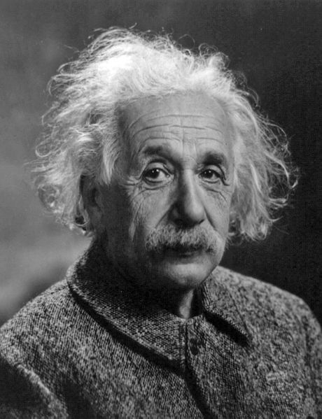
Everything should be as simple as possible but not simpler

