Slide 2
Oral Presentations
Microsoft PowerPoint

Slide 3
Oral presentation elements
Introduction
Materials & methods
Results
Discussion
Conclusions
Further studies
Literature cited or references
Acknowledgements
Notes:
Has elements of a scientific paper published in scientific journal, It is a mini scientific paper presented orally, not a reading of the paper.
These are the elements to include. Remember to make them visual wherever possible. Make choices based on what will improve the effectiveness of your communication.

Slide 4
Oral presentation elements: Introduction
Background (properly cited)
Significance of your study or investigation
Hypothesis
Objectives

Slide 5
Oral presentation elements: Materials & methods
IF EXPERIMENTAL | IF THEORETICAL
Brief description of procedures, materials, etc. (general, not in detail) | Principles on which your study are based
Notes:
General, not in detail

Slide 6
Questions to ask yourself
What are the key points I want the audience to know?
Have I communicated them as simply as possible, but not simpler?
Do I have one message per slide?
Have I used visuals to support my message?
Have I applied design principles effectively?
Does every image or word help convey my message?

Slide 7
Oral presentation delivery tips: Audience
Why should they care?
Grab their attention at beginning—connect with them
Make eye contact
Talk, don’t read
Dress with respect for them
Be enthusiastic
Practice, practice, practice, especially attention material and concluding remarks
Notes:
Do not read your presentation. This is boring and prevents you from making eye contact with the audience and connecting with the audience.

Slide 8
Design for the person
in the back of the room
Notes:
Design for the person in the back of the room. Sometimes this is where decision makers sit—they are busy, they may come late, the remaining seats are in the back of the room.

Slide 9
Pick a simple theme
Keep your slides simple
Apply design principles (CRAP)
Use visuals that support your message
Save often
Notes:
Focus on your content, not the slide
Keep bullets short and clear, don’t have too many elements on a slide

Slide 10
OTHER POWERPOINT TIPS

Slide 11
PowerPoint is a VISUAL aid not a TEXTUAL aid
Notes:
Brain Rule #10: Vision trumps all other senses.
Are you giving a document or a presentation?

Slide 12
You will get 6X better recall if you use visuals to support what you say
Source: http://www.brainrules.net/vision
Notes:
10%
35%
65%

Slide 13
Recognition doubles when pictures are used instead of text
Source: http://www.brainrules.net/vision
Notes:
Source: http://www.brainrules.net/vision

Slide 14
GRAPHS

Slide 15
You will get 6X better recall if you use visuals to support what you say
Notes:
10%
35%
65%

Slide 16
You will get 6X better recall if you use visuals to support what you say
Notes:
10%
35%
65%

Slide 17
Organize your assets
Create a folder for your PPT project
Put copies of any files you will be using in the PPT in this folder
Save the folder for use on a different computer

Slide 18
BACKUPS ARE IMPORTANT!
BELT AND SUSPENDERS

Slide 19
Notes:
If you use a belt and suspenders system, if one breaks, the other one will save you.

Slide 21
OTHER GRAPHICS

Slide 22
Files formats: Raster vs. Vector
.tiff .jpeg .gif
.png .bmp
.emf .eps .wmf
.svg .ai
Notes:
Graphics come in two major categories: raster and vector.
Raster graphics (also called bitmaps) are built out of tiny squares called pixels. Raster graphics come from digital cameras, scanners, and screen captures. Raster graphics are good for photographic images.
Vector graphics are built out of points and lines. Vector graphics can be made larger without pixelating like raster graphics will do when you try to make them larger. Vector graphics tend to be smaller files and are good for illustrations.
If you take your files to a printer, they will let you know what format they need your files to be in. Be sure to work with them early on. The most common file formats that will be requested are TIFF, EPS, and PDF.
The file resolution needs to be higher when printing that when displaying on a screen. 72 dpi (dots per inch) is fine for display on a screen, but you will need 150-300 dpi to result in a good quality printed page.
For more details, see http://www.peachpit.com/articles/article.aspx?p=703794 and http://www.siteimpulse.com/blogen/raster-vs-vector-graphics-and-graphic-file-formats/

Slide 23
INSERTING VIDEO

Slide 24
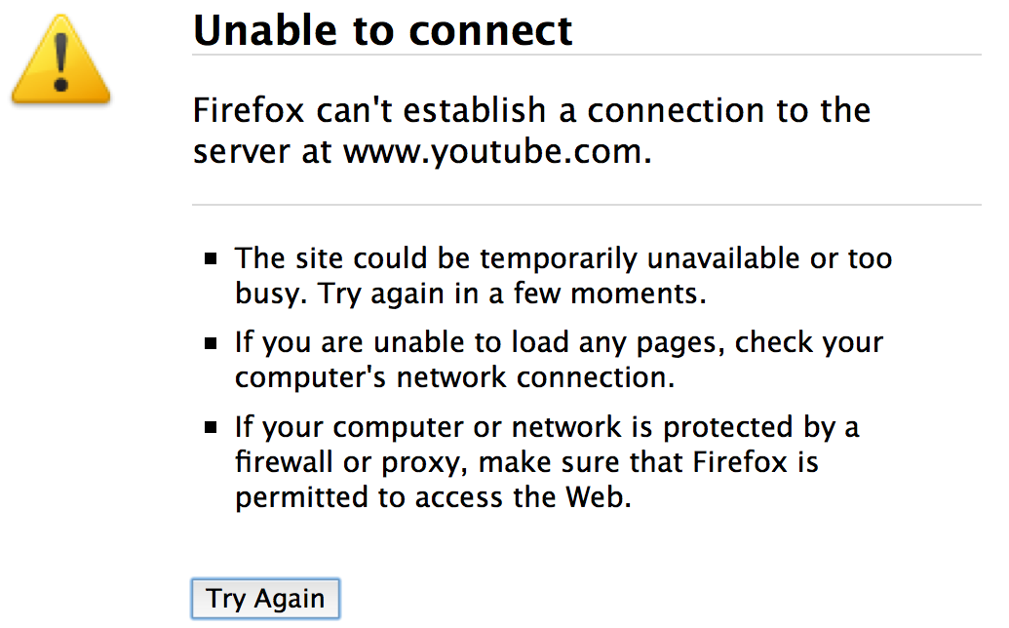
Embed video (instead of linking to it online) so you don’t risk this:

Slide 25
or this:
Buffering
Please stand by

Slide 26
Steps to insert video on a slide
Put a copy of the video in your PPT project folder
Open your PPT file
Select slide where you want video to play
Click Insert→Video and select the file
Position video on slide
Choose playback (automatic or on click)
Test

Slide 27
Steps to take your presentation on the road
Spell check and proofread (a printout can help with this): Review → Spelling
Test your presentation from beginning to end on a big screen: Slide Show → From Beginning
Save your presentation and a backup (belt and suspenders) (you should be saving all along the way)
Optimize compatibility: File → Info → Optimize Compatibility
Save a compressed version: File → Info → Compress Media →pick appropriate quality
Add your info to the file properties: File → Info → Properties

Slide 28
Steps to take your presentation on the road
Click File → Save
Close PPT
Copy PPT project folder for back-up
OR right click and zip folder then copy zipped file

Slide 29
PUTTING IT
ALL TOGETHER
For some great tips you should view the presentation by Michael Alley, “Rethinking the Design of Presentation Slides”. (See Chat for Link).
Notes:
http://www.writing.engr.psu.edu/presentations/speaking.pdf

Slide 30
Resources you may check
“Designing effective scientific presentations” by Susan McConnell
http://www.ibioseminars.org/lectures/bio-techniques/susan-mcconnell.html
“Talking science: Designing and delivering successful oral presentations” by Shawn Mullen
https://videocast.nih.gov/Summary.asp?File=17746&bhcp=1
“Rethinking the design of presentation slides” by Michael Alley http://www.writing.engr.psu.edu/presentations/speaking.pdf

Slide 31
Poster Presentation
Microsoft PowerPoint
Notes:
How many have seen or presented a scientific poster?
If you have seen someone’s poster, what catches your eye?
How are you going to catch someone’s eye?

Slide 32
A good poster shows good composition and is:
Well designed
Uncluttered
Legible
Straightforward
Easy to read
Visuals tell the story you want to convey that incorporates appropriate, brief text
Notes:
* Work done in collaboration with five graduate students in a special course

Slide 33
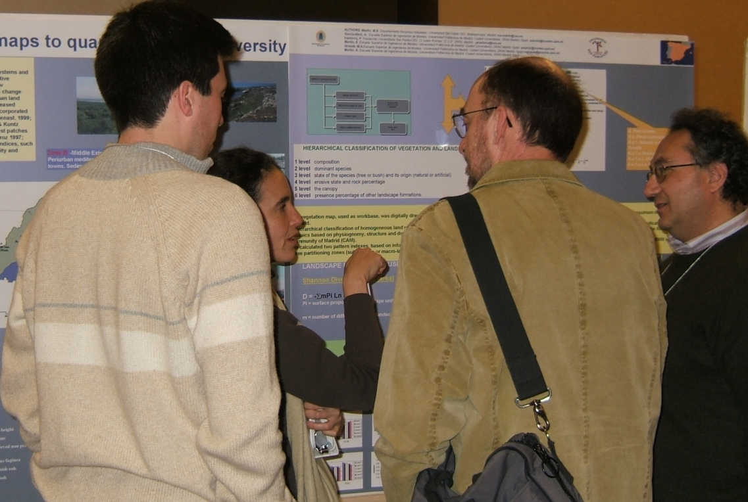
What is a poster?
A visual communication tool
An effective poster will help you …
… engage colleagues in conversation.
George R. Hess
Department of Forestry &
Environmental Resources
North Carolina State University
Raleigh, North Carolina 27695-8002 USA
Notes:
* Work done in collaboration with five graduate students in a special course

Slide 34
An effective poster will help you …
… get your main point across to as many people as possible.
George R. Hess
Department of Forestry &
Environmental Resources
North Carolina State University
Raleigh, North Carolina 27695-8002 USA
Notes:
* Work done in collaboration with five graduate students in a special course

Slide 35
An effective poster …
is easily read from 1-2 meters away
George R. Hess
Department of Forestry &
Environmental Resources
North Carolina State University
Raleigh, North Carolina 27695-8002 USA
Notes:
* Work done in collaboration with five graduate students in a special course

Slide 36
Text
Keep text elements short
Use phrases and active voice
Use serif font for text
San-serif font OK for title & headings
Notes:
* Work done in collaboration with five graduate students in a special course

Slide 37
Layout
Headings identify key sections
Balance placement of text & graphics
Use white space creatively
Don’t fight “reader gravity”
Use a column format
Notes:
Work done in collaboration with five graduate students in a special course
Remember, design can help you organize information and clearly communicate.
Use design to make the poster look interesting and easy to understand so that people will stop and look further.

Slide 38
Typical poster elements
Title
Your name
Your mentor
Affiliation

Slide 39
Typical poster elements
Abstract
Introduction
Materials & methods
Results
Discussion
Conclusions
Further studies
Literature cited or references
Acknowledgements
Notes:
These are some typical poster elements. Organize your information in a way that makes it clear for your particular work.

Slide 40
Poster elements: Abstract
Short summary (≈250 words) written as a single paragraph
hypothesis tested
objectives
methods
results
conclusions
Write it last

Slide 41
Poster elements: Results
Graphs & tables must
be numbered in consecutive order
have titles
have labels or legends
a narrative that describes the result(s)

Slide 42
Poster guidelines
Notes:
Eye goes from top to bottom then left to right

Slide 43
A key section....
Identification
Title
Your name
Your mentor
Affiliation
Notes:
* Work done in collaboration with five graduate students in a special course

Slide 44
Award-winning poster with critique
Notes:
http://www.ncsu.edu/project/posters/examples/Flounder/

Slide 45
Create your poster
Save a copy of the PowerPoint poster template from Dropbox to your computer
Set up your workspace
View → Ribbon
View → Toolbars → Standard & Formatting
View → Guides → Snap to Grid & Shape
Create text boxes for each heading and each element
Notes:
Expansion of guidelines we sent you.

Slide 46
Elements: Literature cited, or references, or bibliography
Keep it short. Use the most relevant
Use the APA style
May use smaller font size
Notes:
* Work done in collaboration with five graduate students in a special course

Slide 47
Elements: Acknowledgements
Mentorship
Funding
Notes:
* Work done in collaboration with five graduate students in a special course

Slide 48
Resources
The Poster Session: A Guideline for Preparation by Carol Waite Connor, U.S. Geological Survey
How to: Posters Presentations & Conferences created by Texas Tech University Center for Undergraduate Research
George R. Hess
Department of Forestry & Environmental Resources
North Carolina State University
Raleigh, North Carolina 27695-8002 USA

Slide 49
Questions
This Photo by Unknown Author is licensed under CC BY-NC-ND
Notes:
How many have seen or presented a scientific poster?
If you have seen someone’s poster, what catches your eye?
How are you going to catch someone’s eye?

